Slide 1
Configuring Application Restriction Policies

Slide 2

Overview
Exam Objective 6.3: Configure Application Restriction Policies
Installing Software with Group Policy
Configuring Software Restriction Policies
Using AppLocker

Slide 3


Installing Software with Group Policy
Lesson 18: Configuring Application
Restriction Policies

Slide 4


Installing Software with Group Policy
Administrators can use Group Policy to install, upgrade, patch, or remove software applications:
  When a computer starts,
  When a user logs on to the network
  When a user accesses a file associated with an application that is not currently on the user's computer
Administrators can use Group Policy to fix problems associated with applications by launching a repair process that will fix the application.

Slide 5

Windows Installer
Windows Server 2012 uses the Windows Installer with Group Policy to install and manage software that is packaged into Microsoft Installer files, with an .msi extension
The client-side component is called the Windows Installer Service:
o Responsible for automating the installation and configuration of the designated software
Server-side component

Slide 6
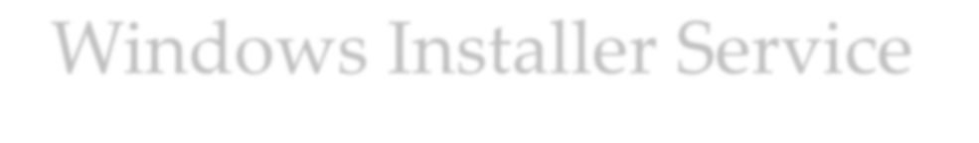

Windows Installer Service Package File
The package file consists of the following information:
An .msi file, which is a relational database file that is copied to the target computer system, with the program files it deploys. In addition to providing installation information, this database file assists in the self-healing process for damaged applications and clean application removal.
External source files that are required for software installation or removal.
Summary information about the software and the package.
A reference point to the path where the installation files are located.

Slide 7
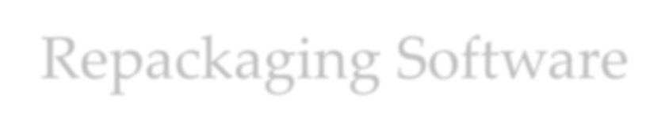
Repackaging Software
Several third-party package-creation applications on the market enable you to repackage software products into a Windows Installer-enabled format.
The process of repackaging software for .msi distribution consists of the following steps:
Take a snapshot of a clean computer system.
Install and configure the application as desired.
Take a snapshot of the computer after the application is installed.

Slide 8

Deploying Software Using Group Policy
Before deploying software using Group Policy, you must create a distribution share—a network location from which users can download the software that they need.
Create a GPO or modify an existing GPO to include the software installation settings, plus one of two options:
  Assign option: Helpful when you are deploying required applications to pertinent users and computers.
  Publish option: Enables users to install the applications
that they consider useful to them.

Slide 9


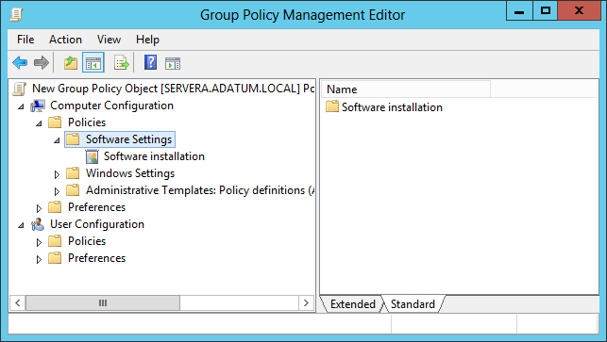
Configure Software Installation Defaults
The Software Settings folder in a GPO

Slide 10
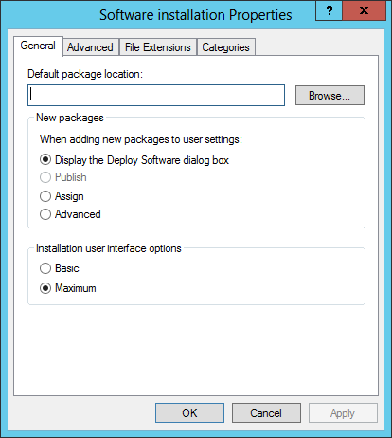
Configure Software Installation Defaults
The Software Installation Properties sheet

Slide 11
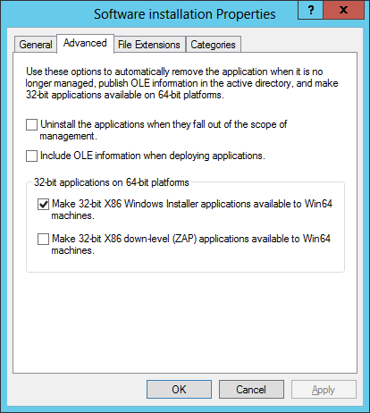
Configure Software Installation Defaults
The Advanced tab of the Software Installation
Properties sheet
© 2013 John Wiley & Sons, Inc.

Slide 12
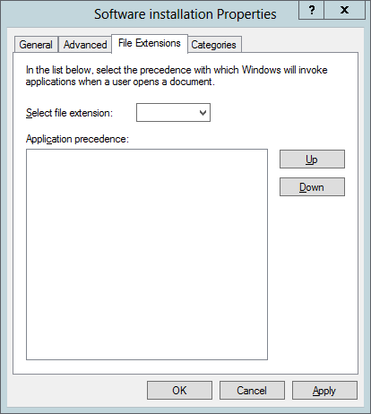
Configure Software Installation Defaults
The File Extensions tab of the Software Installation
Properties sheet
© 2013 John Wiley & Sons, Inc.

Slide 13
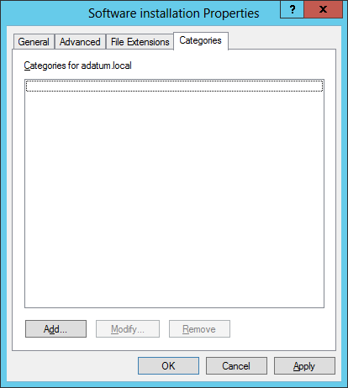
Configure Software Installation Defaults
The Enter new category tab of the Software Installation
Properties sheet
© 2013 John Wiley & Sons, Inc.

Slide 14


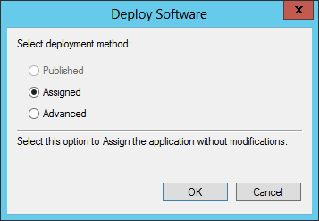
Create a New Software Installation Package
The Deploy Software dialog box

Slide 15


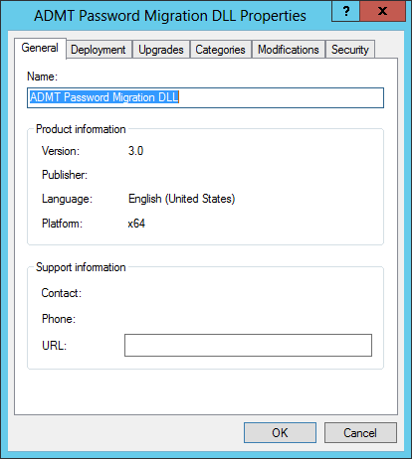
Customizing Software Installation Packages
The Properties sheet of a Windows Installer package

Slide 16
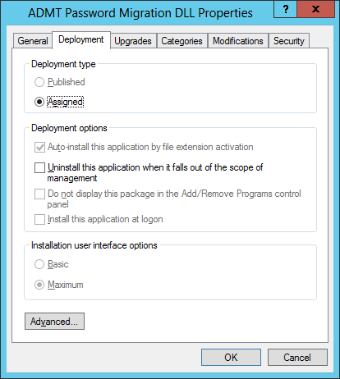
Customizing Software Installation Packages
The Deployment tab on a software installation package’s Properties sheet

Slide 17
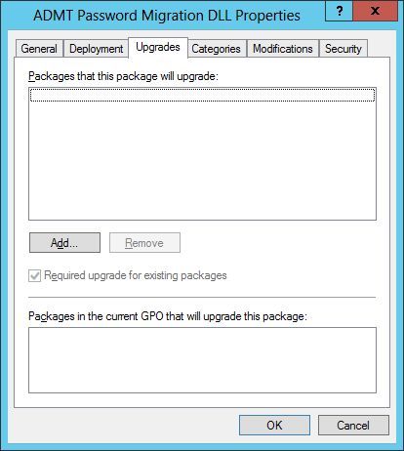
Customizing Software Installation Packages
The Upgrades tab on a software installation package’s Properties sheet

Slide 18
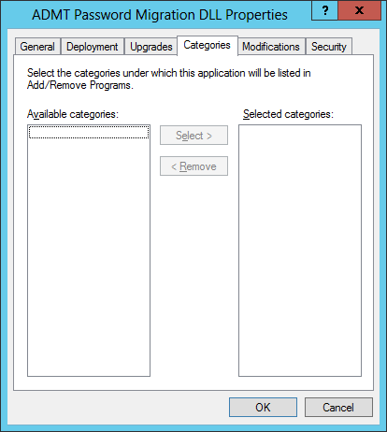
Customizing Software Installation Packages
The Categories tab on a software installation package’s Properties sheet
© 2013 John Wiley & Sons, Inc.

Slide 19
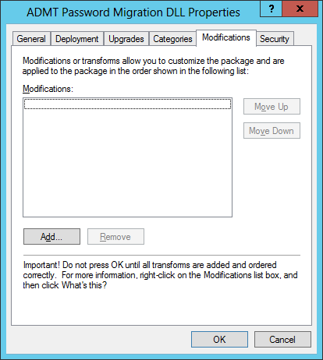
Customizing Software Installation Packages
The Modifications tab on a software installation package’s Properties sheet
19

Slide 20
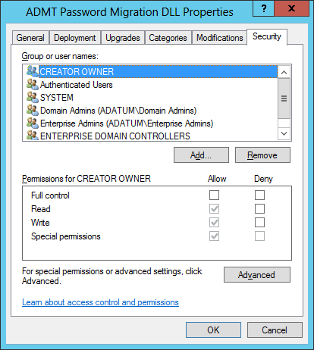
Customizing Software Installation Packages
The Security tab on a software installation package’s Properties sheet

Slide 21


Configuring Software Restriction Policies
Lesson 18: Configuring Application
Restriction Policies

Slide 22


Configuring Software Restriction Policies
Software restriction policies are designed to identify software and control its execution.
Provides organizations greater control in preventing potentially dangerous applications from running.
You can control who is affected by the policies.

Slide 23


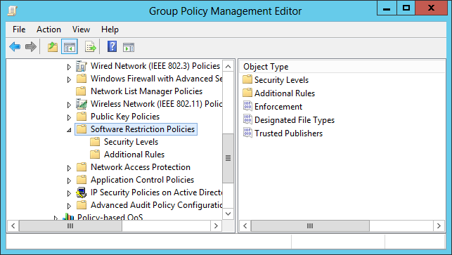
Configuring Software Restriction Policies
The Software Restriction Policies folder

Slide 24
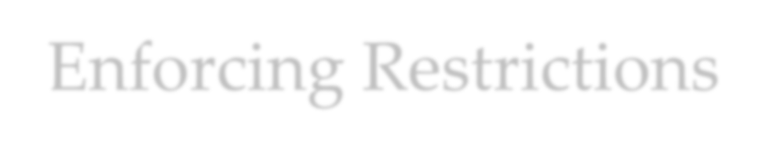
Enforcing Restrictions
If a policy does not enforce restrictions, executable files run based on the permissions that users or groups have in the NTFS file system.
You can use three basic strategies for enforcing restrictions:
  Unrestricted: Enables all applications to run, except those that are specifically excluded.
  Disallowed: Prevents all applications from running
except those that are specifically allowed.
  Basic User: Prevents any application from running that requires administrative rights, but enables programs to run that only require resources that are accessible by normal users.

Slide 25

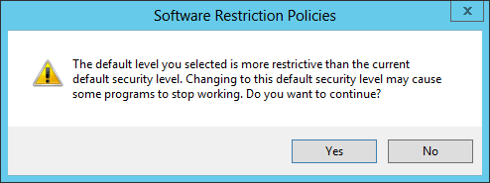
Modify the Default Security Level
Setting the Default Security Level of a software restriction policy

Slide 26

Configuring Software Restriction Rules
There are four types of software restriction rules to specify which programs can or cannot run on your network:
  Hash rules
  Certificate rules
  Path rules
  Network zone rules
You can use multiple rules and they are applied in the order listed above.

Slide 27

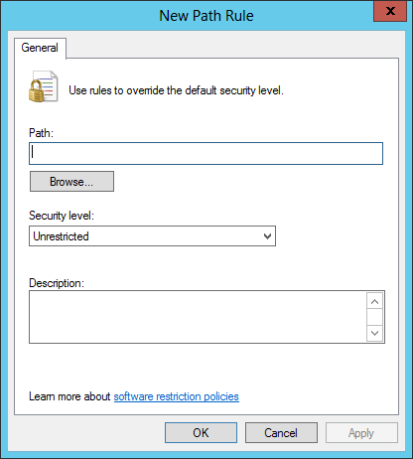
Configuring Software Restriction Rules
The New Path Rule dialog box

Slide 28

Configuring Software Restriction Properties
Within the Software Restriction Policies folder, you can configure three specific properties to provide additional settings that apply to all policies when implemented.
These three properties are:
  Enforcement
  Designated file types
  Trusted publishers

Slide 29

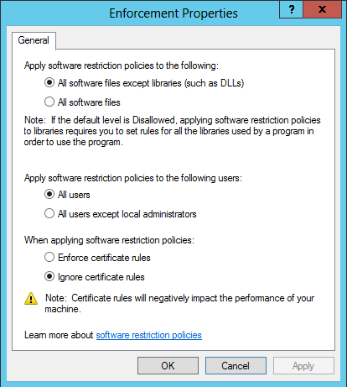
Configuring Software Restriction Properties
Configuring Enforcement properties

Slide 30
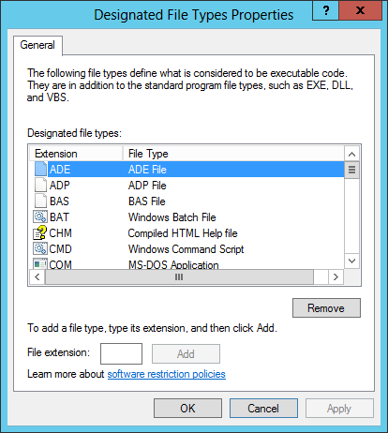
Configuring Software Restriction Properties
Configuring Designated File Types properties

Slide 31
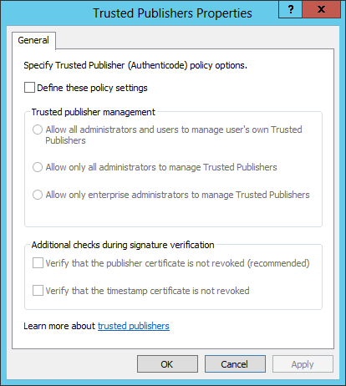
Configuring Software Restriction Properties
Configuring Trusted Publishers properties

Slide 32


Software Restriction Best Practices
Software restriction policies should be used with standard access
control permissions.
The Disallowed Default Security Level should be used cautiously, because all applications are restricted unless explicitly allowed.
If you accidentally create policies that cause undesirable restrictions on a workstation, reboot the computer in Safe Mode to troubleshoot and make changes, because software restriction policies cannot be applied in Safe Mode.
When editing software restriction policies, you should disable them first so that a partially complete policy does not cause undesirable results on a computer.
Creating a separate GPO for software restriction policies enables you to disable or remove them without affecting other policy settings.
Test all policies before deploying them to the users.

Slide 33

Using AppLocker
Lesson 18: Configuring Application
Restriction Policies

Slide 34

AppLocker
AppLocker, also known as application control policies, is a Windows feature that is an updated version of the concept implemented in software restriction policies.
Uses rules, which you must manage, using a wizard-based interface.
More flexible than software restriction policies

Slide 35
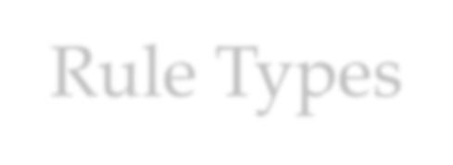
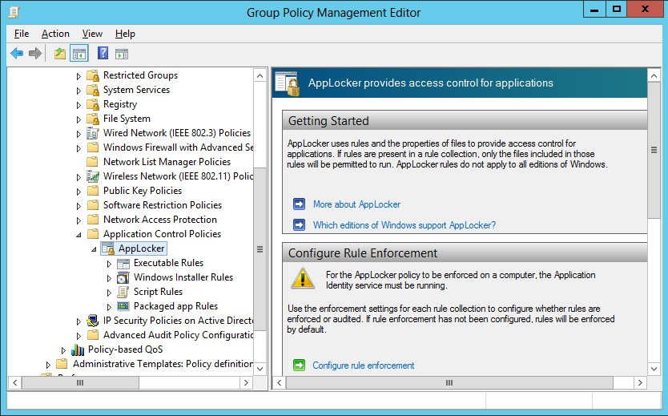
Rule Types
The AppLocker container in a GPO

Slide 36

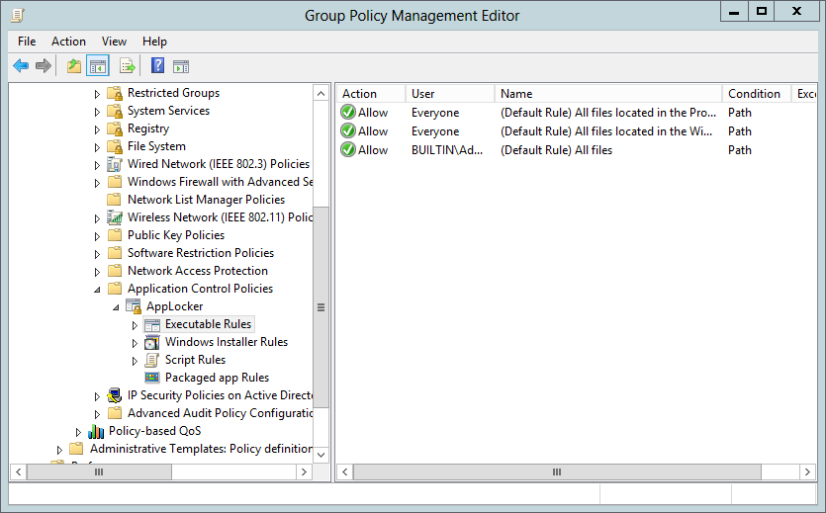
Creating Default Rules
The default AppLocker executable rules

Slide 37

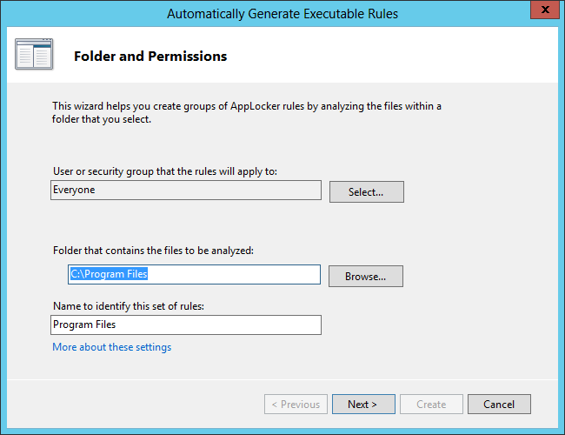
Creating Rules Automatically
The Automatically Generate Executable Rules Wizard

Slide 38
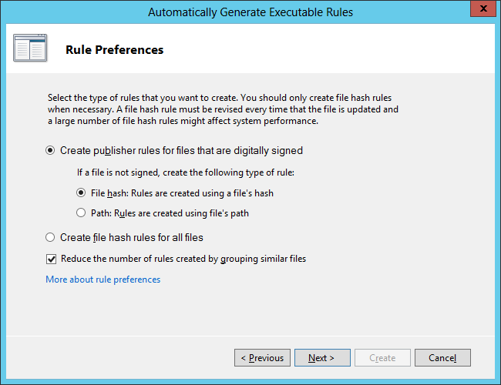
Creating Rules Automatically
The Rule Preferences page of the Automatically Generate Executable Rules Wizard

Slide 39
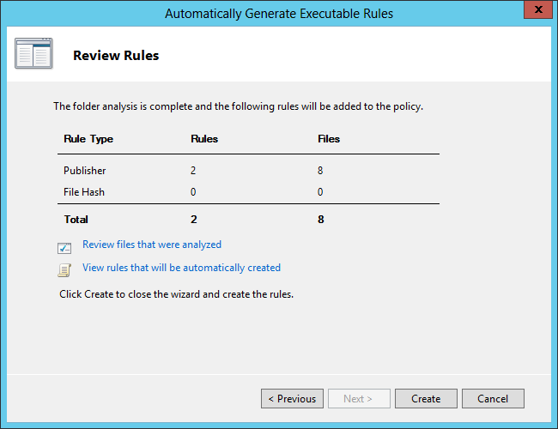
Creating Rules Automatically
The Review Rules page of the Automatically Generate Executable Rules Wizard

Slide 40

Creating Rules Manually
You can also create rules manually, by using a
wizard-based interface.
The wizard prompts you for the following:
  Action: Specifies whether you want to allow or deny the user or group access to the resource. In AppLocker, explicit deny rules always override allow rules.
  User or group: Specifies the name of the user or group to which the policy should apply.
  Conditions: Specifies whether you want to create a publisher, path, or file hash rule. The wizard generates an additional page for whichever option you select, enabling you to configure its parameters.
  Exceptions: Enables you to specify exceptions to the rule you create, using any of the three conditions: publisher, path, or file hash.

Slide 41
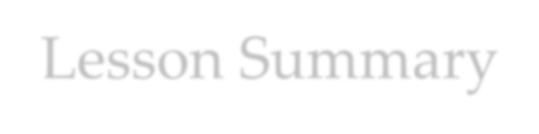
Lesson Summary
You can use Group Policy to deploy new software on your network and remove or repair software originally deployed by a GPO from your network.
The Windows Installer service supports three types of package files: .msi files for standard software installation, .mst files for customized software installation, and .msp files for patching
.msi files at the time of deployment.
You must create a shared folder, called a software distribution point, to store application installation and package files to be deployed by using Group Policy.
Software to be deployed using Group Policy can either be Assigned or Published. Assigning software using the User Configuration node of a Group Policy enables the application to be installed when the user accesses the program using the Start menu or an associated file. Publishing an application enables the application to be available through Control Panel.

Slide 42
Lesson Summary
Software restriction policies enable the software's executable code to be identified and either allowed or disallowed on the network.
The three Default Security Levels within software restriction policies are Unrestricted, which means all applications function based on user permissions; Disallowed, which means all applications are denied execution regardless of the user permissions; and Basic User, which enables only executables to be run that can be run by normal users.
Four rule types can be defined within a software restriction policy. They include, in order of precedence, hash, certificate, path, and network zone rules. The security level set on a specific rule supersedes the Default Security Level of the policy.

Slide 43
Lesson Summary
Software restriction policies are Group Policy settings that enable you to specify the programs that are allowed to run on workstations by creating rules of various types.
AppLocker enables you to create application restriction rules easily.

Slide 44
Copyright 2013 John Wiley & Sons, Inc.
All rights reserved. Reproduction or translation of this work beyond that named in Section 117 of the 1976 United States Copyright Act without the express written consent of the copyright owner is unlawful. Requests for further information should be addressed to the Permissions Department, John Wiley & Sons, Inc. The purchaser may make back-up copies for his/her own use only and not for distribution or resale. The Publisher assumes no responsibility for errors, omissions, or damages, caused by the use of these programs or from the use of the information contained herein.

